Slide 1
Mindful Steps to StressLess

Slide 2
Correlation with Hours of Practice
Emotional reaction to screaming woman reduced in
Mindfulness, Increased in Compassion
Mindfulness Alone
Mindful Compassion
Flexibility and Control of Mind

Slide 3
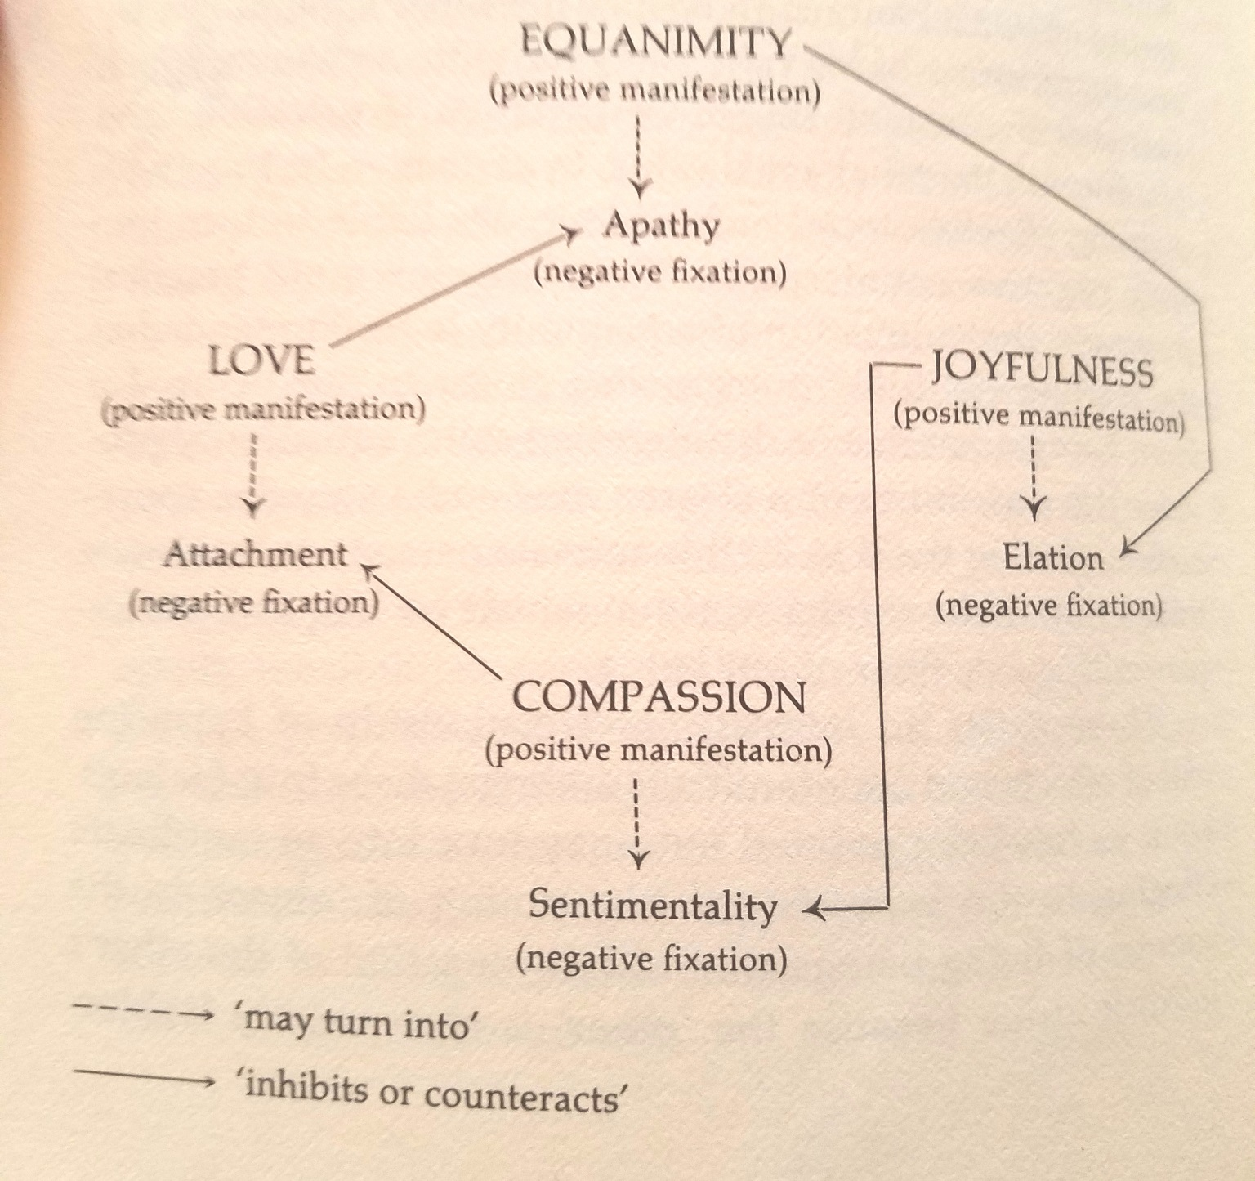
Elements of Compassion
Love
Compassion
Joy
Equanimity

Slide 4
PAIN

Slide 5
-75 healthy, human volunteers to 4 days of the following:
mindfulness meditation,
placebo conditioning,
sham mindfulness meditation
book-listening control
Exposure to Thermal Pain in MRI scanner

Slide 6
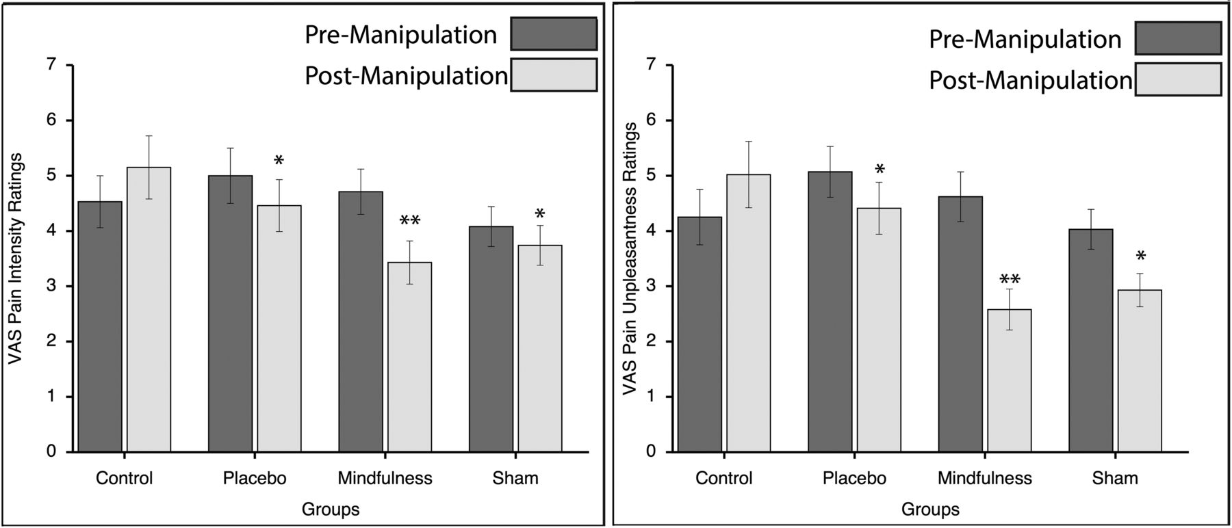
PAIN!
Zeidan et al. 2015 Mindfulness Meditation-Based Pain Relief Employs Different Neural Mechanisms Than Placebo and Sham Mindfulness Meditation-Induced Analgesia J. Neurosci https://doi.org/10.1523/JNEUROSCI.2542-15.2015

Slide 8
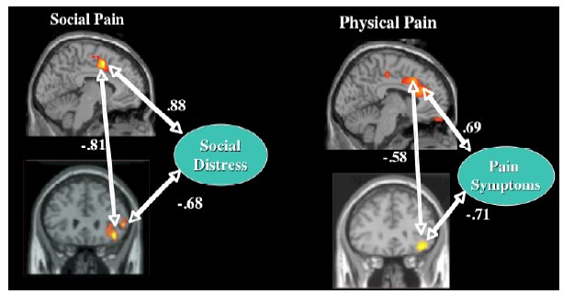
Other kind of pain – Social Pain
DeWall CN, MacDonald G, Webster GD, Masten CL, Baumeister RF, Powell C, Combs D, Schurtz DR, Stillman TF, Tice DM, Eisenberger NI. (2010). Acetaminophen reduces social pain: Behavioral and neural evidence. Psychol Sci. 21:931–7.

Slide 9
Mindfulness and Trauma

Slide 11
Yoga and Resiliency based on Inflammatory factors (Interleukin-6 (IL-6), tumor necrosis factor-alpha (TNF-α), and C-reactive protein (CRP)
Cancer, cardiovascular disease, type II diabetes, arthritis, osteoporosis, Alzheimer’s disease, periodontal disease, and frailty and functional decline
25 novices and 25 experts, were exposed to each of the conditions (yoga, movement control, and passive-video control)
Kiecolt-Glaser, J.K., Christian, L., Preston, H., Houts, C.R., Malarkey, W.B., Emery, C.F. and Glaser, R., 2010. Stress, inflammation, and yoga practice. Psychosomatic medicine, 72(2), p.113.

Slide 12
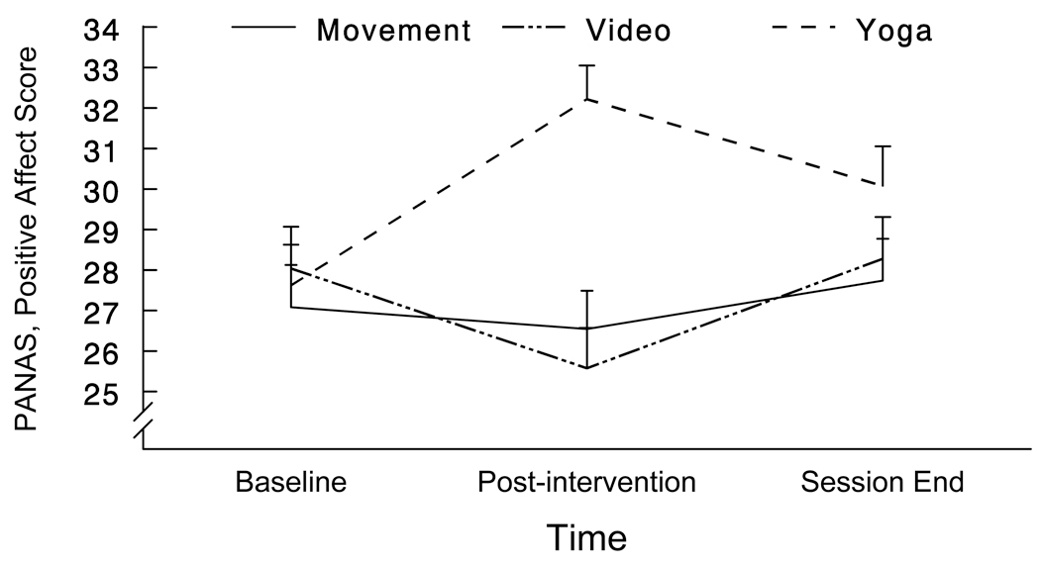
Positive Affect Increased with Yoga vs control conditions

Slide 13
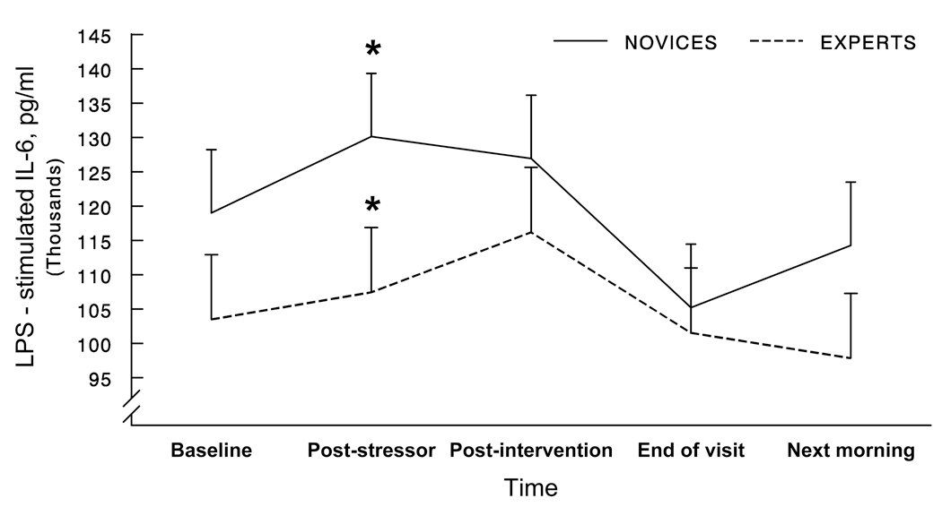
Baseline CytoKine (IL-6) Lower overall in Experts
Yoga Experts vs controls didn’t have systemic inflammatory response to stress task

Slide 14
Relaxation Response Induces Temporal Transcriptome Changes in Energy Metabolism, Insulin Secretion and Inflammatory Pathways
(PLOS Bhasin et al. 2013)
Likely related to Relaxation Response
These genes have been linked to pathways responsible for energy metabolism, electron transport chain, biological oxidation and insulin secretion. These pathways play central roles in mitochondrial energy mechanics, oxidative phosphorylation and cell aging.
We hypothesized that upregulation of biological oxidation gene sets may enhance efficiency of oxidation-reduction reactions and thereby reduce oxidative stress.

