Slide 1
Mindful Steps to StressLess

Slide 2
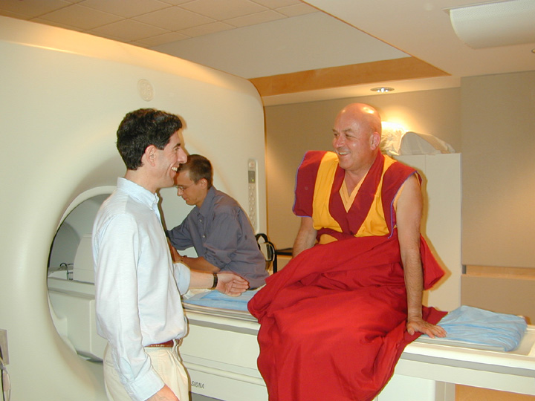
Neuroimaging and Neurodynamical Correlations
Keck laboratory, University of Wisconsin-Madison

Slide 4
Event-Related Sound Presentations
Probing the meditation with distracting sounds

Slide 5
Mindful Attention
Mindful Compassion

Slide 6
Listening Exercise Instructions – Pick a partner
Person 1: One minute relate something mildly challenging while Person 2 listens with mindful attention and no verbal communication
Bell ring
Person 1: One minute relate something positive
Bell ring – Switch speaker vs. listener
Person 2: Something mildly challenging
Bell ring
Person 2 Something positive
Compassion Exercise – switch partners
Person 1: Something positive while Person 2 listens with mindful compassion
Bell ring
Person 2 Something positive

Slide 7
Review of Compassion Intervention studies
21 randomized controlled trials (RCT; n = 1468) supported overall effectiveness of FIM on depressive symptoms (d = 0.38 )
Loving-Kindness, Compassion, Four Immeasurables
Jing, L. V., et al. "The effect of four Immeasurables meditations on depressive symptoms: A systematic review and meta-analysis." Clinical Psychology Review (2020): 101814.

Slide 8
Compassion Training Alters Altruism and Neural Responses to Suffering
Helen Weng ... Richie Davidson et al 2013
Psychological Science

Slide 9
Redistribution game (think game is real)

Slide 10
fMRI experiment – emotional distress

Slide 11
Compassion and not reappraisal increased activity in social-related brain regions

