Slide 1
The Art and Science of Meditation
Julie A. Brefczynski-Lewis

Slide 2
Goals of the Science Portion of this Course
Give a realistic view of what one can expect from practice, free from both hype and anti-hype in context of history of the field
Help give confidence in your practice via well-vetted studies of mindfulness meditation
Use scientific data to help point out the type of state mindfulness is aiming for

Slide 3
Mindfulness Based Stress Reduction (MBSR)
Relaxation exercises
Derived from Western Psychology
Gentle Yoga exercises
Derived from Hatha Yoga
Meditation on breath
Derived from a basic attention practice in Buddhism
Loving-kindness Meditation
Compassion towards self and others

Slide 4
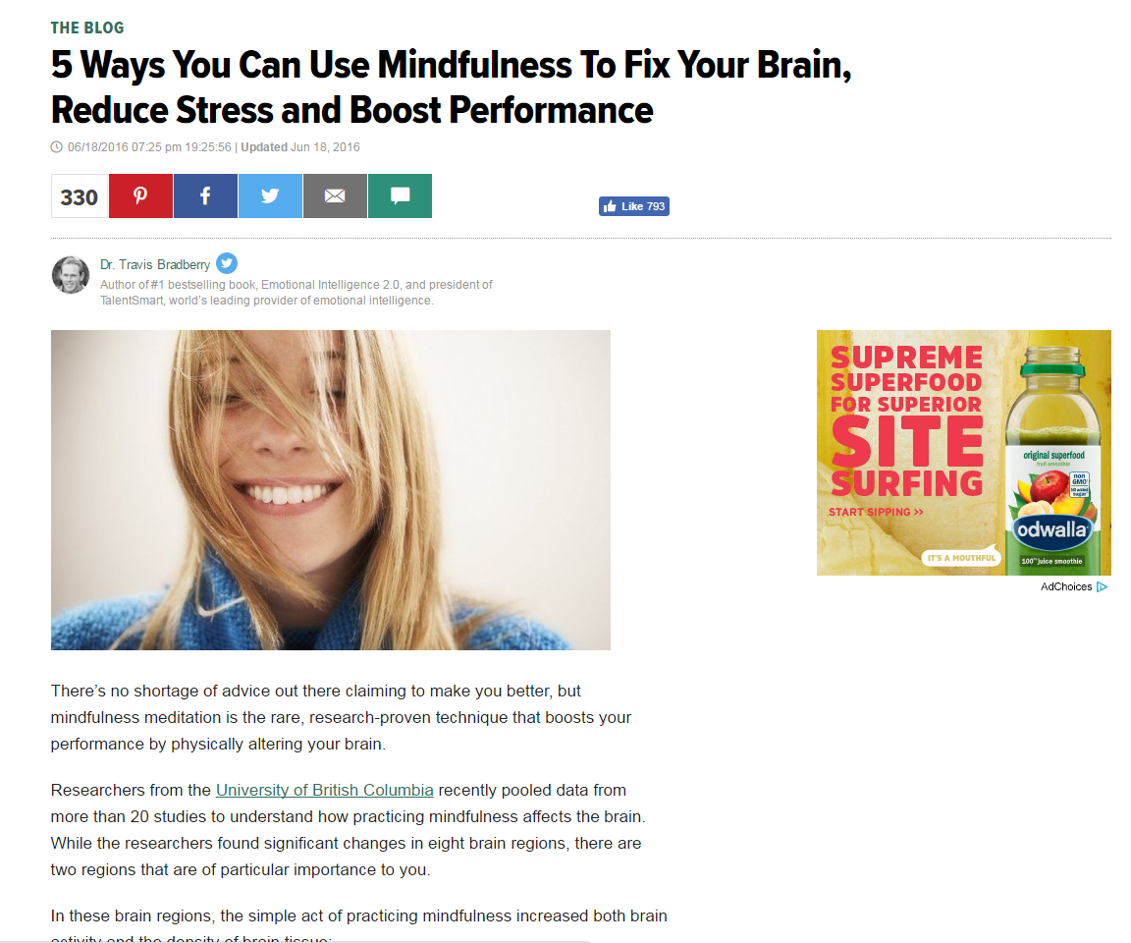

Slide 6
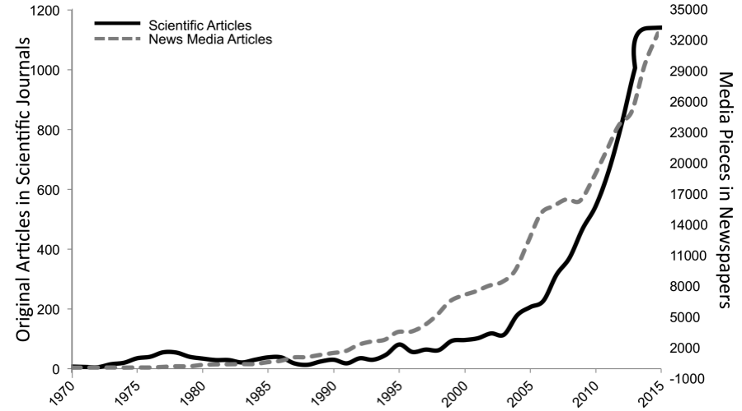

Slide 7
Transcendental Meditation (TM)
Similar to Mindfulness meditation but on a one word “mantra” – sometimes even the word “calm” for example
Early shoddy research in TM tarnished its reputation
Seems to have become more secularized but early movement had a ‘new age’ feel

Slide 8
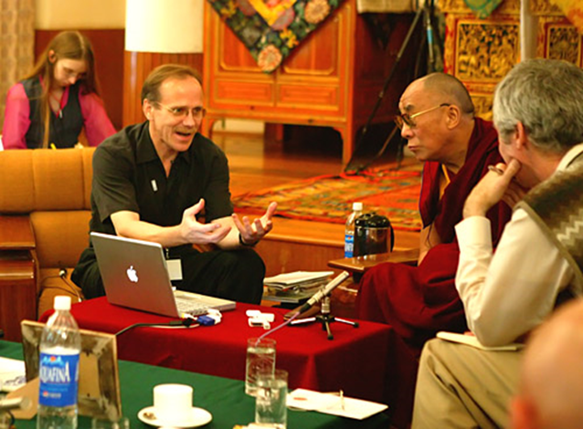
Movement to create more rigorous standards surrounding meditation research
Secular and applicable to all types of people
Including Proper Control Groups
Not relying solely on “self report” factors
Including non-meditators in your research group
Mind and Life Institute

Slide 9
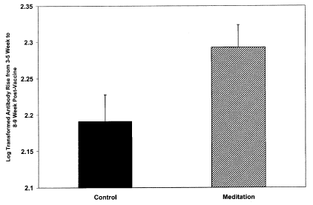
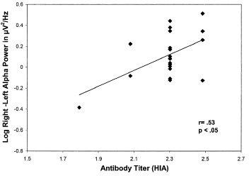
Alterations in Brain and Immune Function Produced by Mindfulness Meditation (Psychosomatic Medicine,Davidson et al., 2003)
Antibody rise from the 3- to 5-week to the 8- to 9-week
Correlation between change in EEG prefrontal α-asymmetry from Time 1 to Time 2 and rise in antibody titers
Adapted from slide by Dorjee, et al. UMass

Slide 10
Van Dam, Nicholas T., et al. "Mind the hype: A critical evaluation and prescriptive agenda for research on mindfulness and meditation." Perspectives on Psychological Science 13.1 (2018): 36-61.

Slide 11
Meditation Programs for Psychological Stress and Well-being: A Systematic Review and Meta-analysis JAMA Internal Medicine Goyal et. Al 2014
Included 47 of 18,753 citations (with 3515 participants)
Anxiety, Depression and Pain
Stress, Quality of Life
Similar effectiveness as medication, exercise and other well studied therapies

Slide 12
How does mindfulness work?
Body changes – even at a cellular level that come from relaxation
Brain changes – even at a structural level that come from neuroplasticity (Next week!)

Slide 13
Relaxation Response (RR)
Mindfulness, Yoga, Tai Chi; Qi Gong; progressive muscle relaxation; biofeedback; and breathing exercises [14].
Elicitation of the RR is associated with coordinated biochemical changes, characterized by decreased oxygen consumption [15], carbon dioxide elimination, blood pressure, heart and respiratory rate [16], [17], and norepinephrine responsivity [18], as well as increased heart rate variability [18], [19], and alterations in cortical and subcortical brain regions [20], [21].

Slide 14
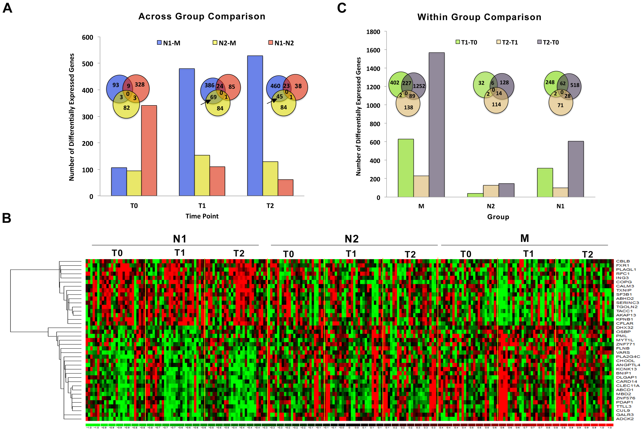
Relaxation Response Induces Temporal Transcriptome Changes in Energy Metabolism, Insulin Secretion and Inflammatory Pathways
(PLOS Bhasin et al. 2013)
One session of RR practice (20 min) -rapid changes in gene expression (on the order of minutes)
These genes have been linked to pathways responsible for energy metabolism, electron transport chain, biological oxidation and insulin secretion. These pathways play central roles in mitochondrial energy mechanics, oxidative phosphorylation and cell aging.
We hypothesized that upregulation of biological oxidation gene sets may enhance efficiency of oxidation-reduction reactions and thereby reduce oxidative stress.

Slide 16
Overall Summary
-”Mindfulness” and “Meditation” practices tend to refer to a range of practices that relax the autonomic nervous system and increase attention and awareness of the present moment
-Rigorous studies in neuroscience and cellular biology have shown beneficial health effects of meditation
-Mindfulness is not a panacea, but does have potential benefit for health benefits, with a low risks of side effects

